Slide 1


World Quant IQC’ 24 Team Oblivion INDIAN INSTITUTE OF TECHNOLOGY PATNA
ADITYA PRAKASH | YAGYESH ANSHUL | AARAV SHYAM
Here is where your presentation begins

Slide 2

Slide Line
Alpha 01
Alpha 02
Alpha 03
Based on pre-tax income and capital efficiency
Region : CHN
Universe : TOP3000
Overview of the alpha 02
Region : USA
Universe : TOP1000
Overview of the alpha 03
Region : USA
Universe : TOP200

Slide 3

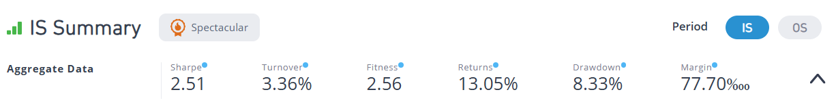
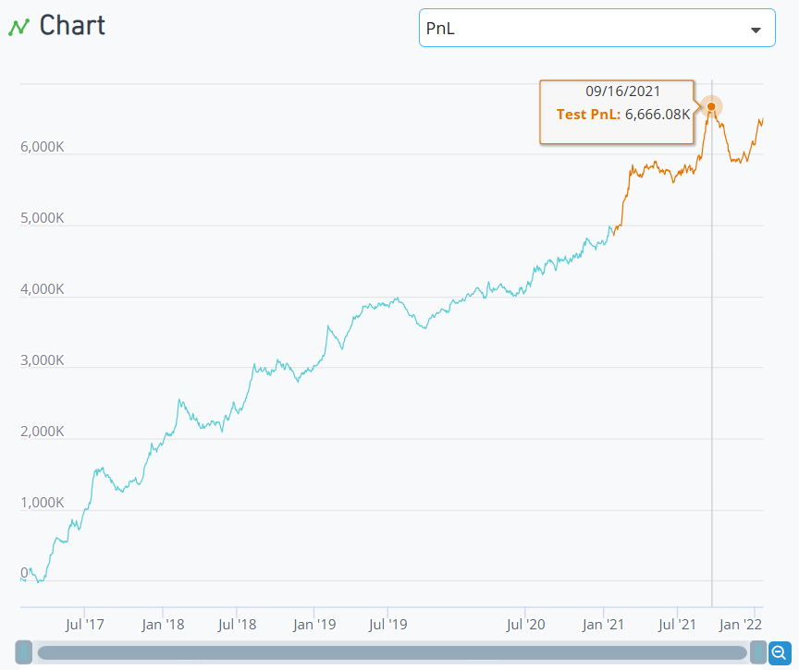
Alpha 01
Source of Idea
The idea behind is that companies with higher pretax income over an extended period of time, along with being efficient with their capital usage, are more likely to perform better within same type of companies.
Hypothesis
Companies that rank high in both pre-tax income over time and capital efficiency within their industry are likely to be stronger performers and potentially better investment opportunities.

Slide 4
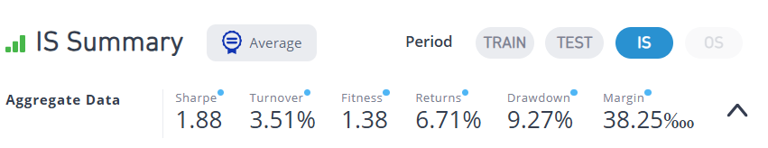
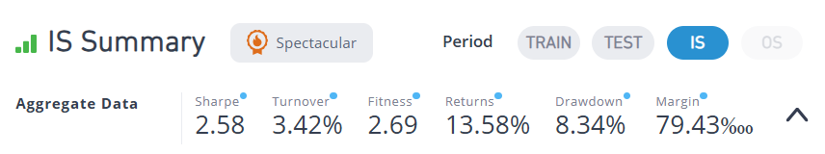
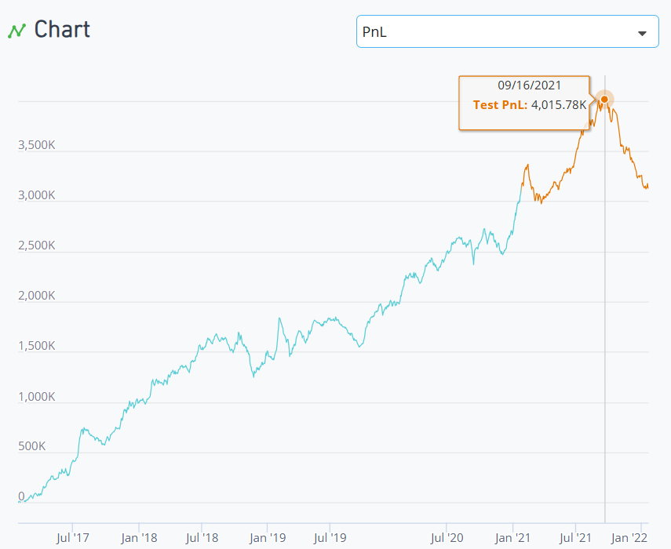
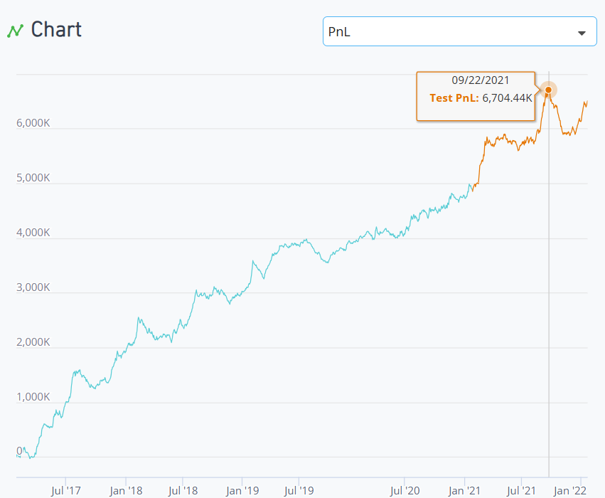
First Implementation :
Scope of Improvement :
Operators | Datasets :
The first implementation was to rank companies with higher pre-tax income over an extended period, suggesting better performance persistently.
This revised model aims to identify companies that not only generate high revenues but also effectively manage their tax liabilities, leading to better overall performance.
group_rank , ts_rank , quantile | pretax_income , income_tax , sales , cap

Slide 5
References
Earnings Before Tax (EBT) vs Pretax Income - Overview, How To Calculate (corporatefinanceinstitute.com)
Pretax Profit Margin: Definition, Uses, Calculation, Example (investopedia.com)
Alpha 01
Alpha 02
Links here
Alpha 03
Links here

Slide 6



Thanks
Aditya Prakash
Yagyesh Anshul
Aarav Shyam

Slide 7
Contents of This Template
There’s what you’ll find in this Slidesgo template:
A slide structure based on a consulting sales pitch, which you can easily adapt to your needs. For more info on how to edit the template, please visit Slidesgo School or read our FAQs.
An assortment of photos that are suitable for use in the presentation can be found in the alternative resources slide.
A thanks slide, which you must keep so that proper credits for our design are given.
A resources slide, where you’ll find links to all the elements used in the template.
Instructions for use.
Final slides with:
The fonts and colors used in the template.
A selection of illustrations. You can also customize and animate them as you wish with the online editor. Visit Storyset to find more.
More infographic resources, whose size and color can be edited.
Sets of customizable icons of the following themes: general, business, avatar, creative process, education, help & support, medical, nature, performing arts, SEO & marketing, and teamwork.
You can delete this slide when you’re done editing the presentation

Slide 8
Table of Contents
01
Alpha 1
02
Alpha 2
03
Alpha 3
Here you could describe the topic of the section
Here you could describe the topic of the section
Here you could describe the topic of the section

Slide 9
Alpha
01
Hypothesis
Companies that rank high in both pre-tax income over time and capital efficiency within their industry are likely to be stronger performers and potentially better investment opportunities.

Slide 10
Our Company
Mercury is the closest planet to the Sun and the smallest one in the Solar System—it’s only a bit larger than the Moon. The planet’s name has nothing to do with the liquid metal, since it was named after the Roman messenger god, Mercury

Slide 11
The Problem
Mercury is the closest planet to the Sun and the smallest one in the Solar System—it’s only a bit larger than the Moon. The planet’s name has nothing to do with the liquid metal, since it was named after the Roman messenger god, Mercury

Slide 12
Understanding the Problem
Jupiter
Mars
Saturn
Jupiter is the biggest planet of them all
Despite being red, Mars is a cold place
It’s composed of hydrogen and helium

Slide 13
Maturity Model
BasBasi | Basic | Below Average | Average | Advanced | World- Class
Procurement Strategy
Organization & Human resources
Procurement Processes
Technology
Supplier relationship

Slide 14
The “Entering a New Market” Framework Includes 3 Components
Desirability
Feasibility
Profitability
Sweet Spot

Slide 15
Business Roadmap
Phase 3
Phase 2
Phase 1
Describe this phase
Describe this phase
Describe this phase
Describe this phase
Describe this phase
Describe this phase
Describe this phase
Describe this phase
Describe this phase

Slide 16
SWOT
Strengths
Weaknesses
Internal
Insert your own text
Insert your own text
Insert your own text
Insert your own text
Opportunities
Threats
External
Insert your own text
Insert your own text
Insert your own text
Insert your own text

Slide 17
Financial Analysis
Starting cash position
Sources of cash
Closing cash position
Uses of cash

Slide 18
Ansoff Growth Matrix
Insert your own title
Market Development Strategy
Diversification Strategy
New
Market
Market Penetration Strategy
Product
Development Strategy
Current
Current
New
Products

Slide 19
Segmentation by Distribution
Price per unit
Revenue
# of units sold
Company Profit
Variable costs
Cost
Fixed costs

Slide 20
Strategy Map
Jupiter
Mars
Jupiter is the biggest planet of them all
Despite being red, Mars is a cold place

Slide 21
Our Solution
Mercury
Venus
Mercury is the closest planet to the Sun and the smallest one in the Solar System—it’s only a bit larger than the Moon
Venus has a beautiful name and is the second planet from the Sun. It’s terribly hot—even hotter than Mercury

Slide 22
Awesome Words

Slide 23
—Someone Famous
“This is a quote, words full of wisdom that someone important said and can make the reader get inspired”

Slide 24

A picture is worth a thousand words

Slide 25
5,600.00
Big numbers catch your audience’s attention

Slide 26

A picture always reinforces the concept
Images reveal large amounts of data, so remember: use an image instead of a long text

Slide 27
02
Target
You could enter a subtitle
here if you need it

Slide 28
Our Target
Gender
Age
60%
25 - 35
40%
36 - 45
Interests

Slide 29
Percentages
55%
80%
60%
Jupiter is the biggest planet of them all
Despite being red, Mars is a cold place
It’s composed of hydrogen and helium

Slide 30
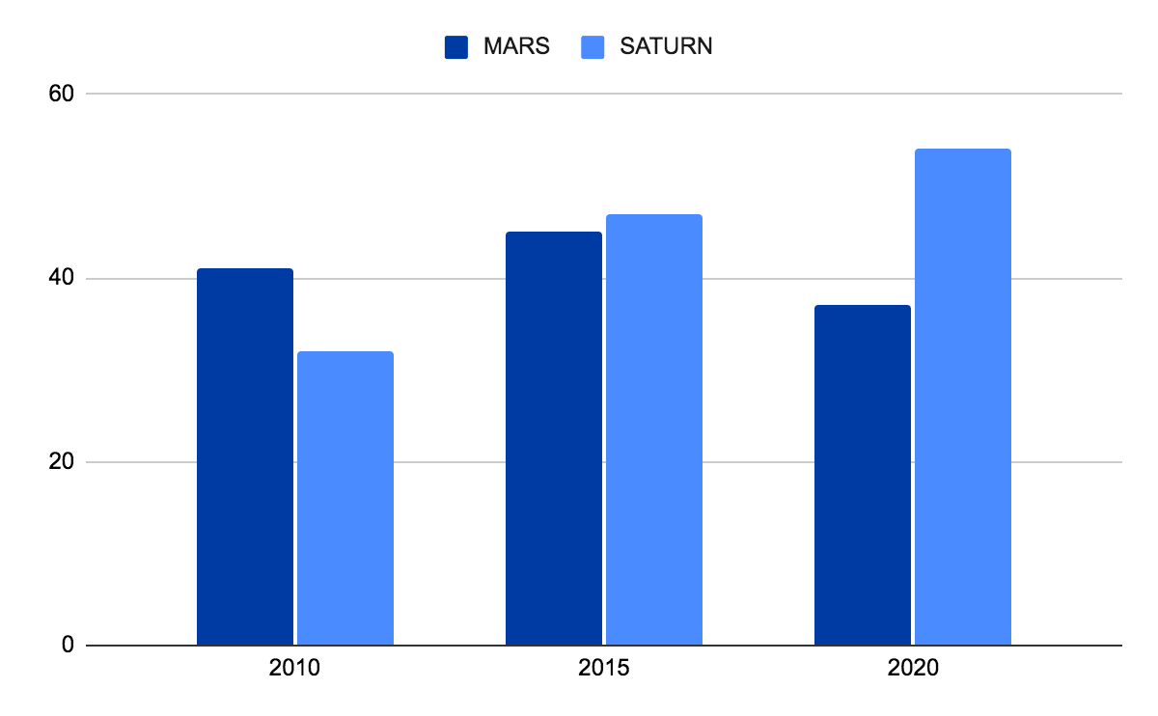

Market Research
Mars (23%)
Venus (43%)
Mercury (34%)
To modify these graphs, click on them, follow the link, change the data and paste the new graphs here, replacing these ones
$450,000,000
Total Revenue in the Sector

Slide 31
Our Partners
Mercury
Venus
Mercury is the closest planet to the Sun
Venus has a beautiful name, but it’s hot
Jupiter
Mars
It’s the biggest planet in the Solar System
Despite being red, Mars
is a cold place

Slide 32
Testimonials
“Venus has a beautiful name and is the second planet from the Sun. It’s terribly hot”
—John Doe
“Mercury is the closest planet to the Sun and the smallest one in the Solar System”
—Helena Patterson

Slide 33
Upcoming Goals
Main Goal
Subgoal 1
Subgoal 2
Mars
Venus
Jupiter
Saturn
Earth

Slide 34
Awards
Mercury
Venus
Mars
Mercury is the closest planet to the Sun and the smallest one
Venus has a beautiful name, but it’s
terribly hot
Despite being red, Mars is actually a
cold place
Jupiter
Saturn
Neptune
Jupiter is the
biggest planet in
the Solar System
Saturn is the
ringed one and a
gas giant
Neptune is the
farthest planet from the Sun

Slide 35
Alternative Resources
Photos:
Side view businessman calculating finance numbers
Happy woman working laptop
Close up woman working laptop
Man with laptop posing coworkers

Slide 36
Resources
Did you like the resources on this template? Get them for free at our other websites.
Photos:
Business woman looking out window sitting office
Top view office desk with growth chart hands with keyboard
Front view elegant business woman using laptop with copy space
Business man enjoying day office

